Slide 1
Defense Biometric Identification System Pre-Enrollment
Security & Emergency Services
November 10, 2022

Slide 2
Pre-Enrollment
DSCR will not be notified in advance of any pre-enrollments
Background checks will not be conducted on any system for those individuals that have pre-enrolled.
A person that pre-enrolls is not fully registered until the process is completed at the Visitor Center.
The system keeps the information for a maximum of 30 days – visitors must enter their information on the pre-enrollment site within 30 days of their visit.
Link to Pre-enrollment: https://dbids-global.dmdc.mil/enroll#!/

Slide 3
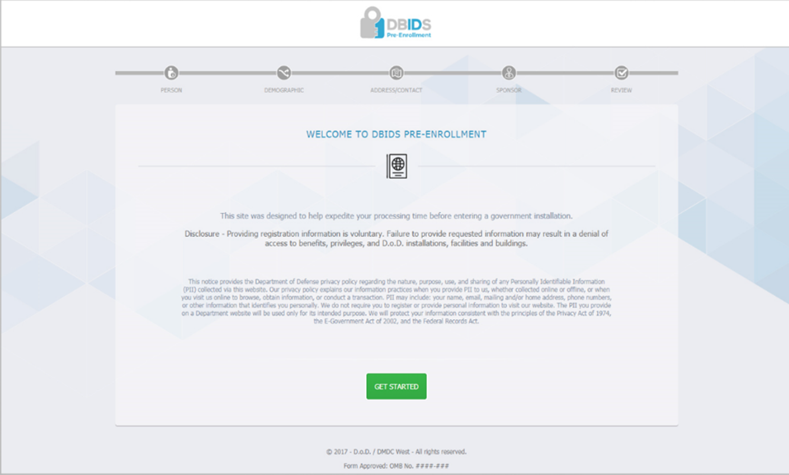
Pre-Enrollment
Click to get started

Slide 4
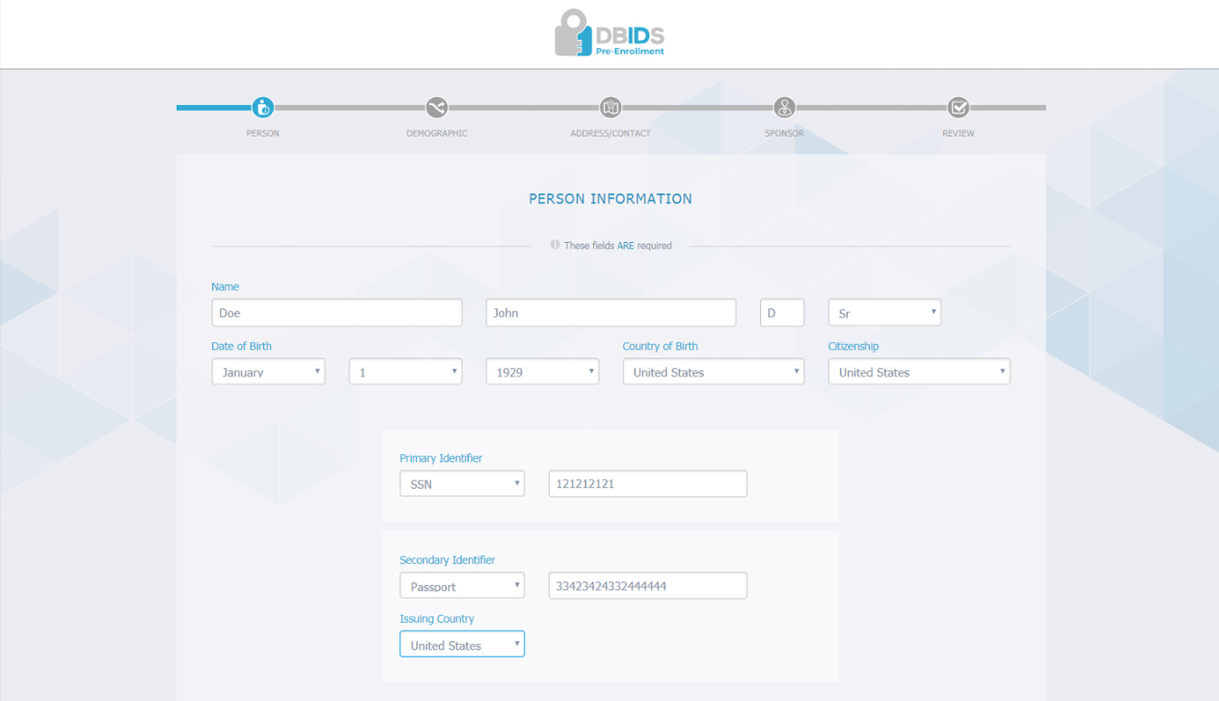
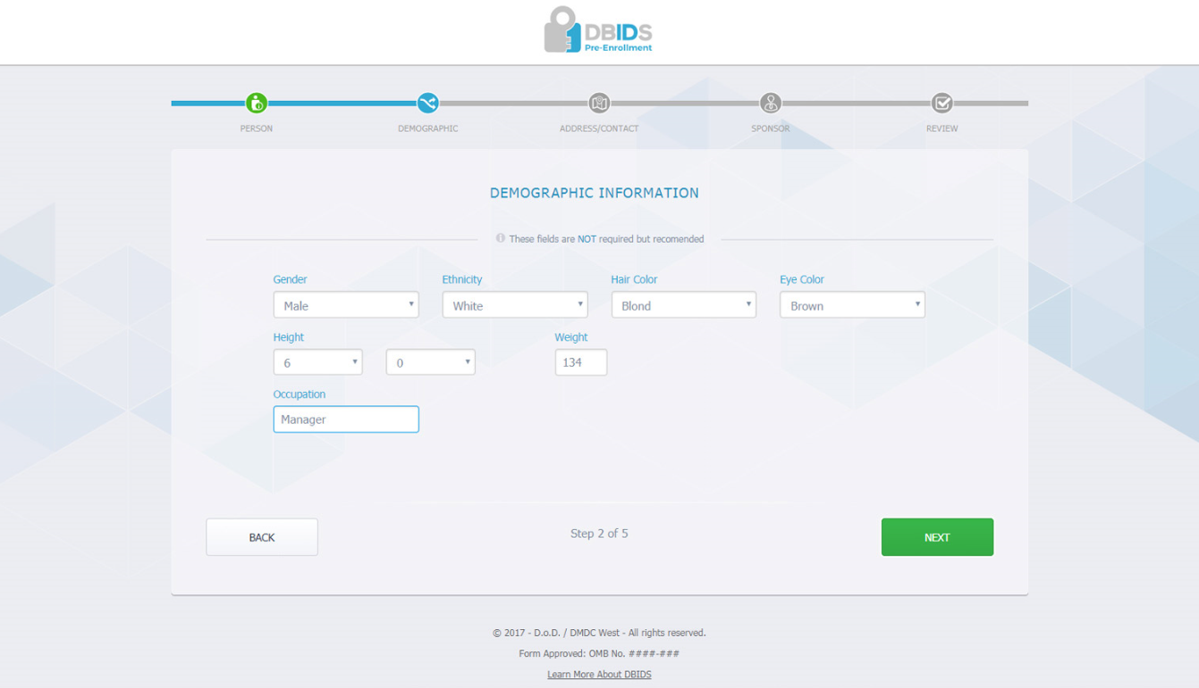
Pre-Enrollment
Identifications must be valid, not expired,
state or federal photo ID
Primary Identifier is required. Secondary is required if Foreign National
Select next

Slide 5
Pre-Enrollment
This information is not required but, may be added at the Visitor Center
Select next

Slide 6
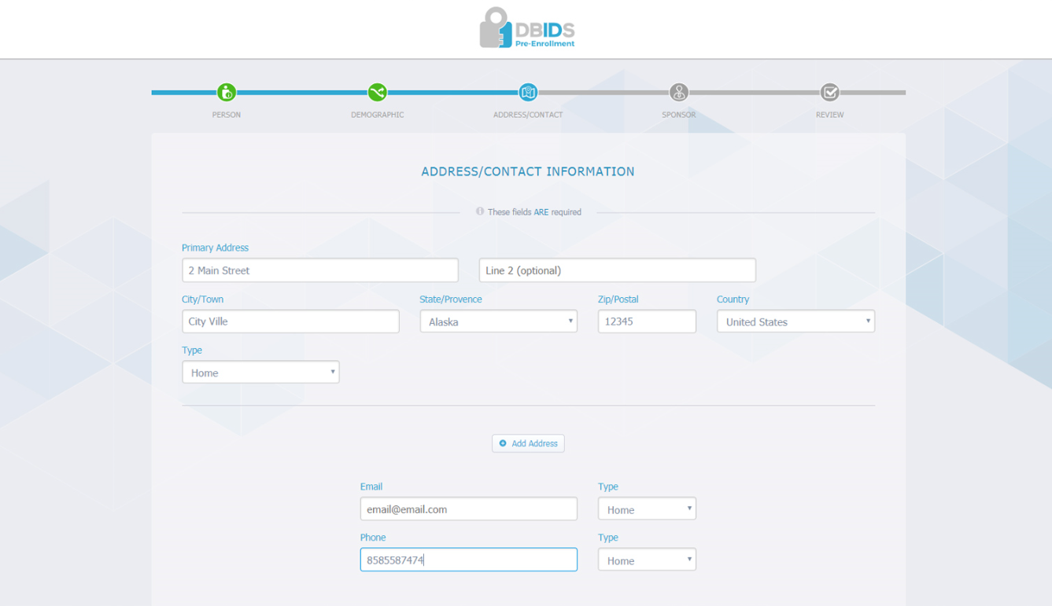
Pre-Enrollment
All information is required before moving on
Select next

Slide 7
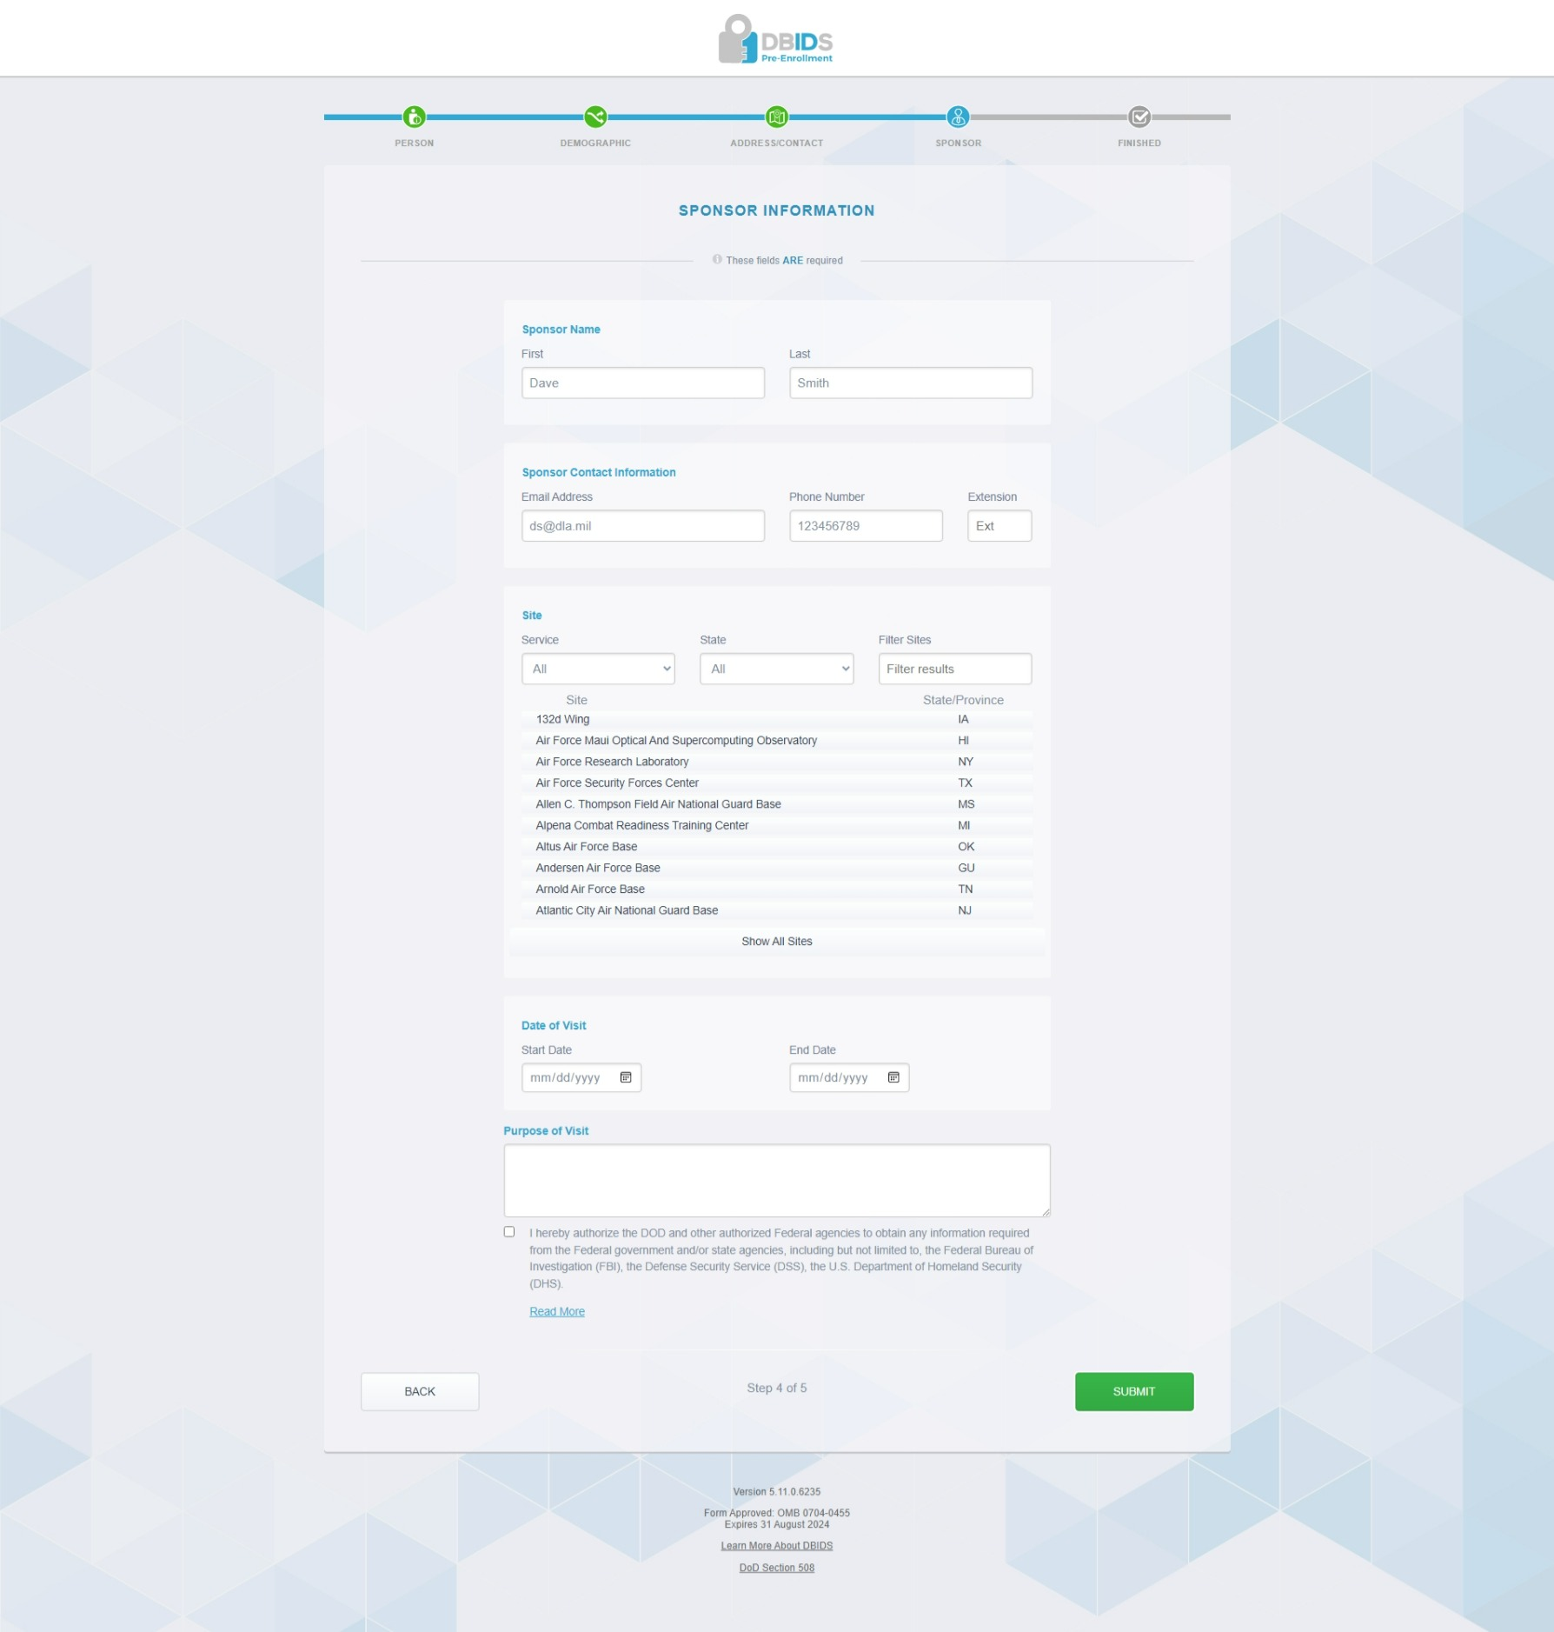

Information is required before moving on
Purpose of visit required
Submit

Slide 8
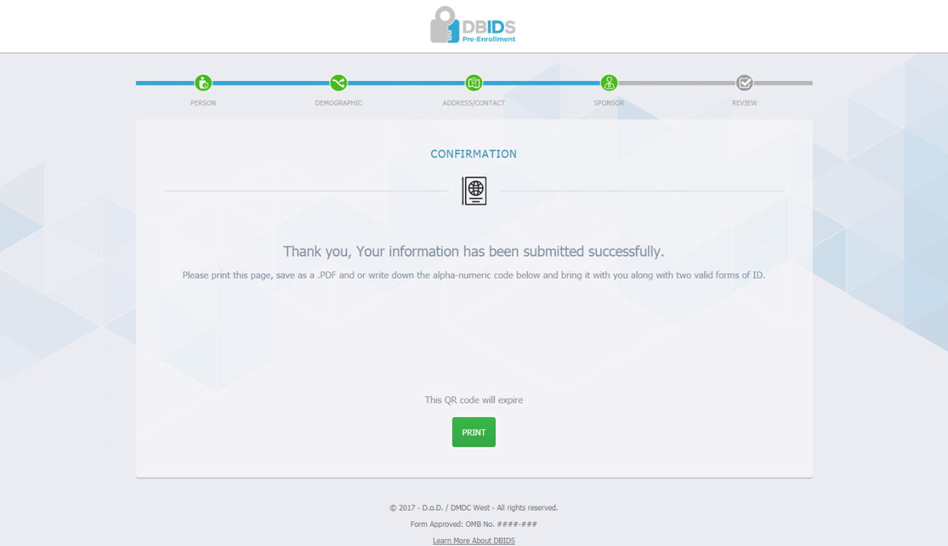
Pre-Enrollment
Send QR code to Sponsor
Print PDF for your Record

